Slide 1
Capstone Engagement
Assessment, Analysis, and Hardening of a Vulnerable System

Slide 2
Table of Contents
This document contains the following sections:
Network Topology
01
02
Red Team: Security Assessment
03
Blue Team: Log Analysis and Attack Characterization
Hardening: Proposed Alarms and Mitigation Strategies
04

Slide 3
Network Topology
<number>

Slide 4
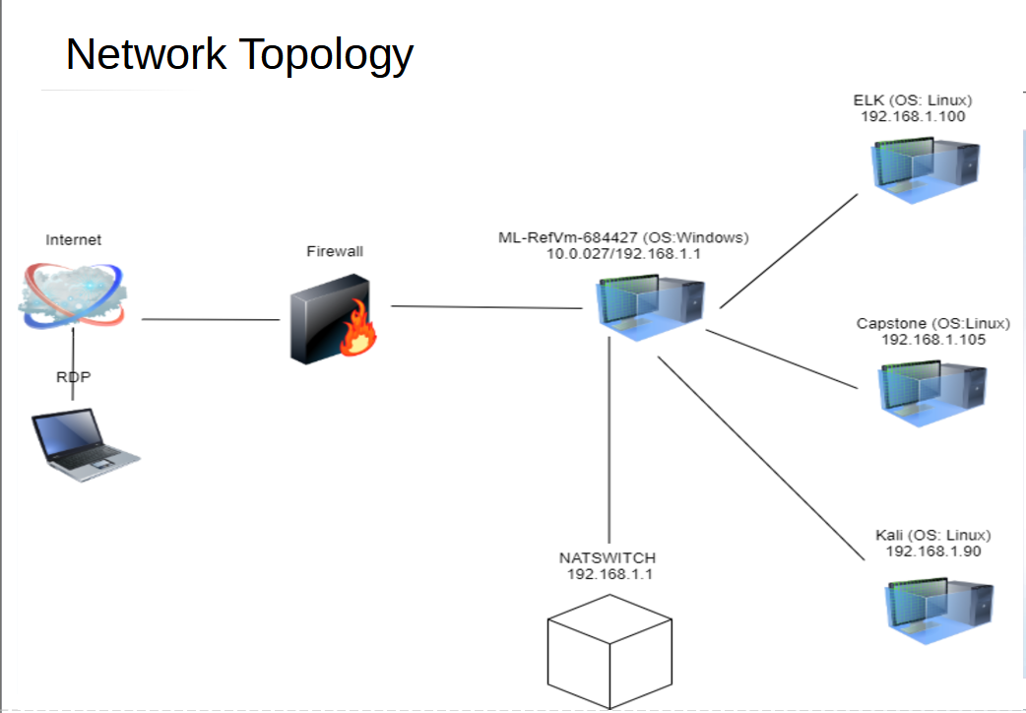
Network Topology
[Insert Here]
Use draw.io to create a diagram of the network.
Add your diagram to this slide and fill out the data in the sidebar.
Network
Address Range:
Netmask:
Gateway:
Machines
Ipv4:192.168.1.100
OS:LINUX
Hostname: ELK
Ipv4:192.168.1.105
OS: LINUX
Hostname: CAPSTONE
Ipv4: 192.168.1.90
OS:LINUX
Hostname: KALI
Ipv4:192.168.1.1
OS: WINDOWS
Hostname: ML-RefVm-684427

Slide 5

Red Team
Security Assessment
<number>

Slide 6
Recon: Describing the Target
Nmap identified the following hosts on the network:
Hostname | IP Address | Role on Network
Kali | 192.168.1.90 | Penetration testing system
ELK | 192.168.1.100 | SIEM System
ML-RefVm-684427 | 192.168.1.1 | NAT Switch
Capstone | 192.168.1.105 | Web Server

Slide 7
Vulnerability Assessment
The assessment uncovered the following critical vulnerabilities in the target:
Vulnerability | Description | Impact
Reverse shell backdoor (CVE-2019-13386) | Reverse shell payload can be deployed on the web server since the firewall permits outbound ports | php allows attackers to execute a shell command, i.e., obtain a reverse shell with user privilege.
LFI Vulnerability | LFI allows access into confidential files on a site. | An LFI vulnerability allows attackers to gain access to sensitive credentials.
Directory listing is enabled in Apache Web Server | One can use the browser to read other people’s directories. | The users and the administrators’ details can be revealed to the attacker.

Slide 8
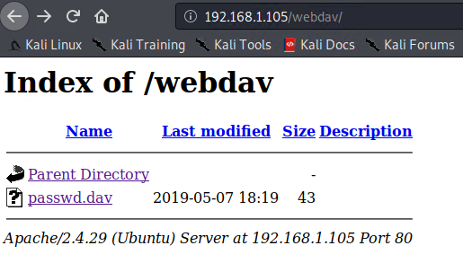
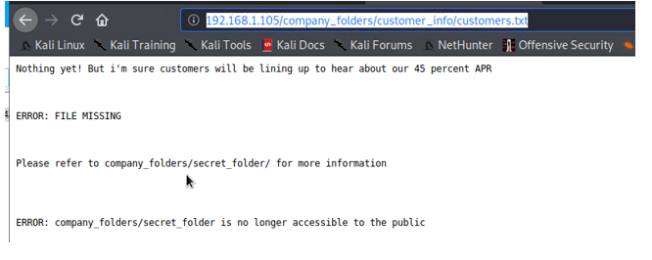
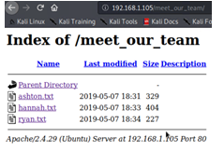
Exploitation: Directory listing Permitted on the server
01
02
03
Tools & Processes
Used nMap to scan the network.
$ nmap -Ss -A 192.168.0.1/24.
Used browser and directory path to find hidden folder .
Achievements
Got the path to hidden directory
[INSERT: screenshot or command output illustrating the exploit.]

Slide 9

Exploitation: LFI Vulnerability
01
02
03
Tools & Processes
Used the Hydra brute force to attack the bash tool and consequently got the stored password.
Achievements
Was able to get informmation for /webdav/ system and got access to the stored password.
Hydra -l ashton -P rockyou.txt s 80 f vV 192.168.1.105 http-get company_folders/secret_folder

Slide 10
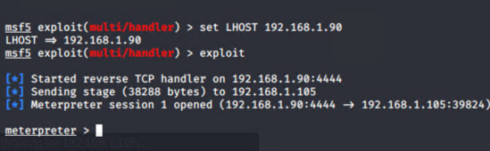
Exploitation: Reverse shell Backdoor
01
02
03
Tools & Processes
Uploaded an msfvenom payload: php/meterpreter/reverse_tcp
Achievements
I was granted access to the Capstone server’s root directory and also was able to gain acess to the user shell.
[INSERT: screenshot or command output illustrating the exploit.]
meterpreter > shell
find / -iname flag.txt
2 > /dev/null
<result of find>: /flag.txt
cd/cat flag.txt
<result of cat>: b1ng0w@5h1sn@m0

Slide 11

Blue Team
Log Analysis and Attack Characterization
<number>

Slide 12
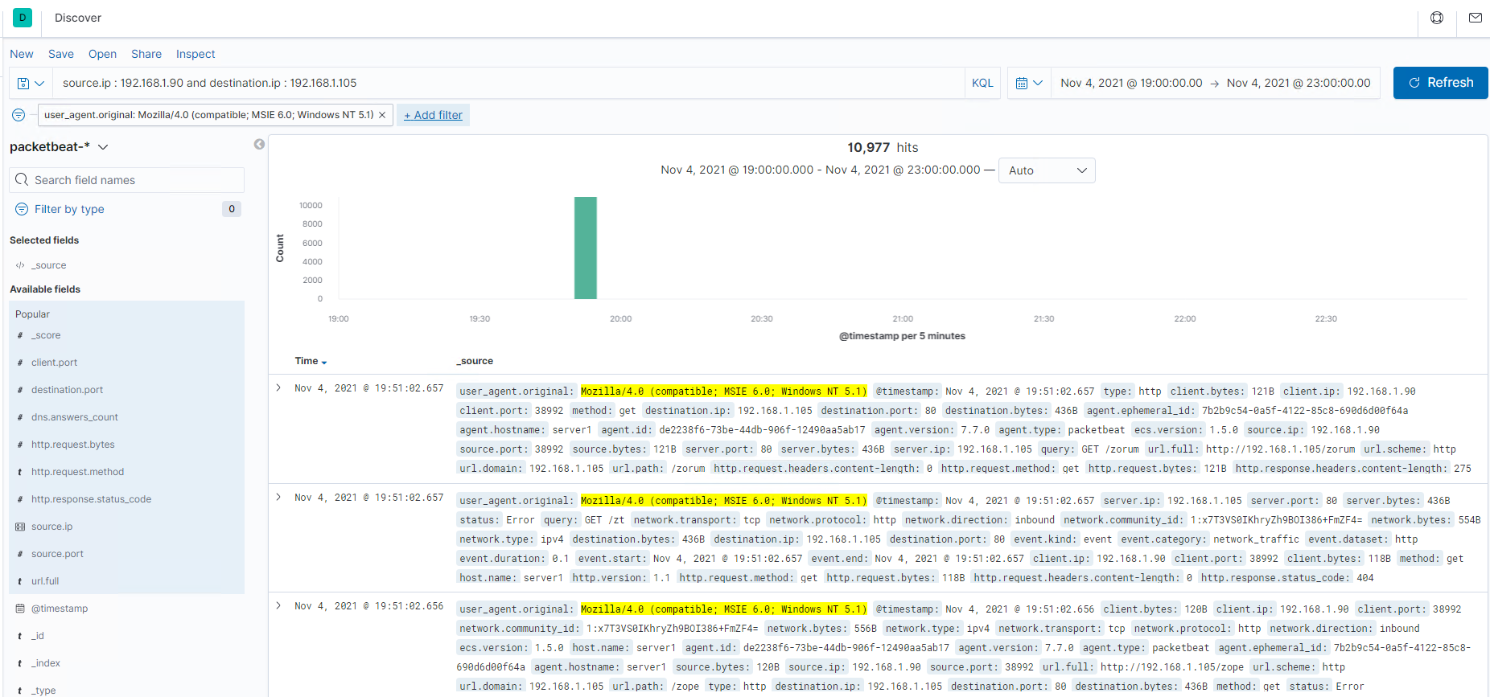

Analysis: Identifying the Port Scan
Answer the following questions in bullet points under the screenshot if space allows. Otherwise, add the answers to speaker notes.
What time did the port scan occur?
How many packets were sent, and from which IP?
What indicates that this was a port scan?
[Insert Here]
Include a screenshot of Kibana logs depicting the port scan.

Slide 13
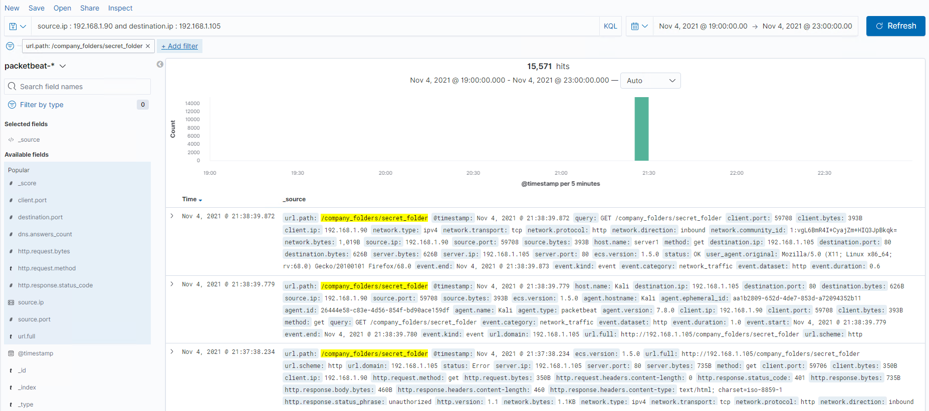
Analysis: Finding the Request for the Hidden Directory
Answer the following questions in bullet points under the screenshot if space allows. Otherwise, add the answers to speaker notes.
What time did the request occur? How many requests were made?
Which files were requested? What did they contain?
[Insert Here]
Include a screenshot of Kibana logs depicting the request for the hidden directory.

Slide 14
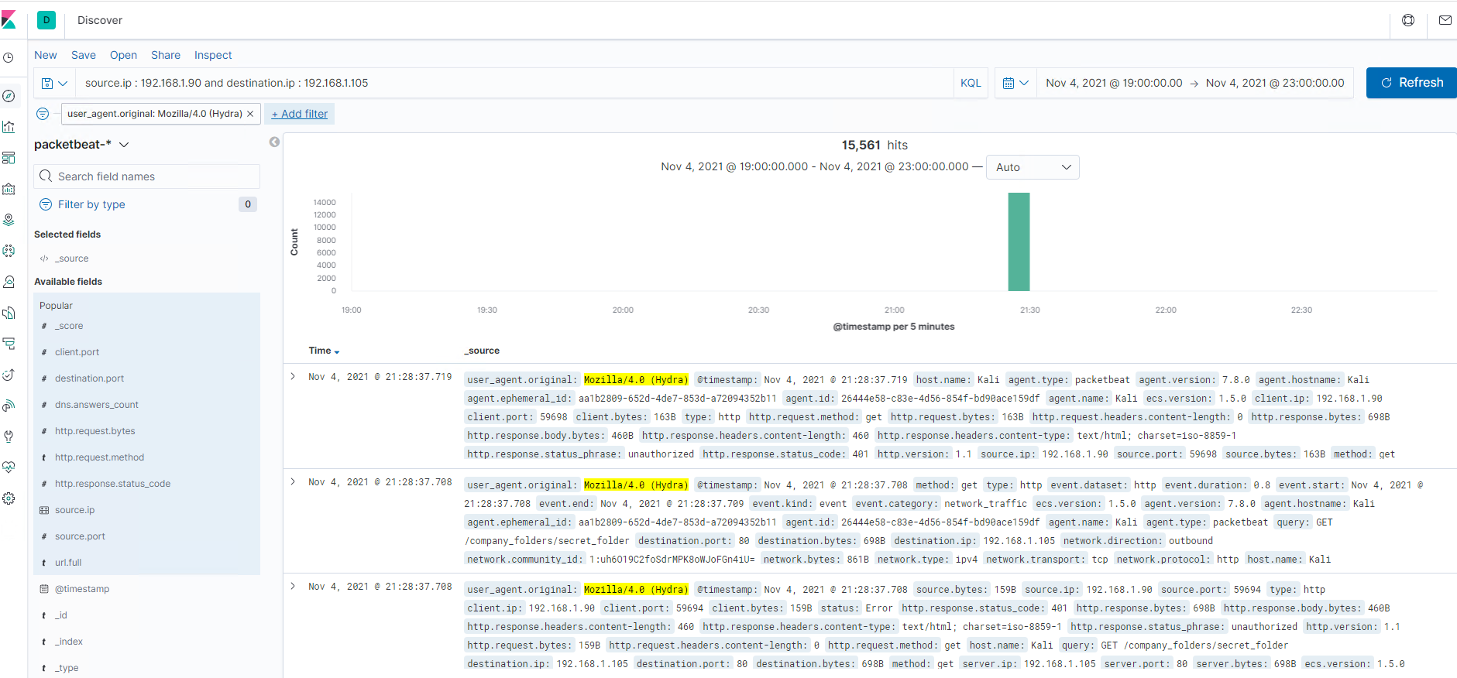
Analysis: Uncovering the Brute Force Attack
Answer the following questions in bullet points under the screenshot if space allows. Otherwise, add the answers to speaker notes.
How many requests were made in the attack?
How many requests had been made before the attacker discovered the password?
[Insert Here]
Include a screenshot of Kibana logs depicting the brute force attack.

Slide 15
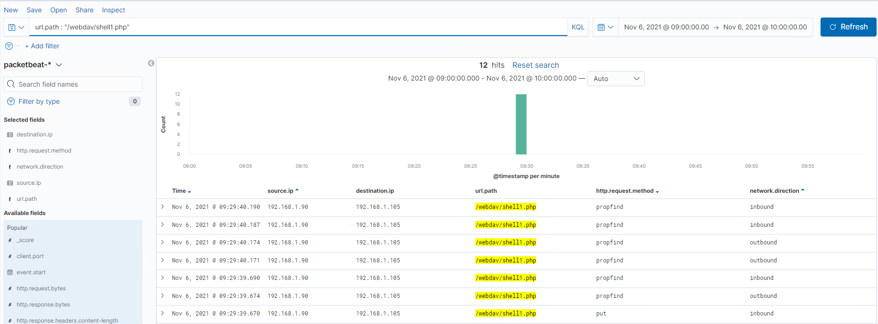
Analysis: Finding the WebDAV Connection
Answer the following questions in bullet points under the screenshot if space allows. Otherwise, add the answers to speaker notes.
How many requests were made to this directory?
Which files were requested?
[Insert Here]
Add a screenshot of Kibana logs depicting the WebDAV connection.

Slide 16
Blue Team
Proposed Alarms and Mitigation Strategies
<number>

Slide 17
Mitigation: Blocking the Port Scan
An alert email can be sent and all port scans should be logged. The threshold that would set this alarm would be when more than 10 port scans have been made from the same IP and at the same time sever alert for anything above 100 port scans from same IP.
Configure firewalls and IDS to detect and block probes.
Use custom rules to lock down the network and block unwanted ports.
Run port Scanning tools to determine whether the firewall accurately detects the port scanning activities.

Slide 18
Mitigation: Finding the Request for the Hidden Directory
We can create 2 types of alerts. First one is low level for more than 3 password failures in a given time frame of 5 seconds.Other one could be a critical alert for more than 10 failures in 5 seconds.
Set a timeout of 30 minutes for more than 3 password failures and that time increases with every failure . An IP should be blacklisted after 10 failed password attempts. Increase password strength requirements to directory .Password reset every 60 days .
Also secret folders should enforce permissions in order to access them .

Slide 19
Mitigation: Preventing Brute Force Attacks
An alert email on all password portals and files if more than 3 failed attempts. Another way could be to send an alert email if the event code = 4625 and is more than 3 in a 5 second interval. Critical alert for 10 failed attempts.
If there are multiple failed login attempts in a short period of time , the IP should be blocked. A very strong and undetectable password should also be enforced. If a user fails to login, they should be given a security question to answer. The use of CAPTCHA would also detect if the user is a human and not a robot. Use of 2 factor authentication. Restrict access to authentication emails.

Slide 20
Mitigation: Detecting the WebDAV Connection
Log and email alerts are generated when foreign IPs request access to protected folders and files. The alarm would be set off when the directory is requested by a non-trusted IP even once.
Limit user access to webdav. Whitelisting Ips. Scanning all incoming traffic with antivirus/antimalware. Update regularly OS.

Slide 21
Mitigation: Identifying Reverse Shell Uploads
Email and log alerts when a ‘put’ method is used on protected folders and files by unauthorized IPs.
http:request.method:”put” and url.path: *webdav* and source.ip: (not 192.168.1.1 or 192.168.1.105)
Make modifications on the configuration file to block unauthorized access to the ‘secret folder from untrusted IPs.
Set up antivirus/antimalware. Upate firewall rules.Limit file types that can be uploaded especially php.

